Slide 1

Software Project III Presentation
Project Title: Waste Management System
Presented By
1.MD.Al-Amin (221-15-5443)
2.Joyanta Kumar Sarker(221-15-5443)

Slide 2
Outline
Objective
Design Phase
Development Phase
Future Work
Conclusion
Software Project III Presentation

Slide 3





Objective
Design a simple and informative webpage.
Provide details about waste management services
Raise awareness about efficient waste management practices.
Create a user-friendly interface.
Software Project III Presentation

Slide 4
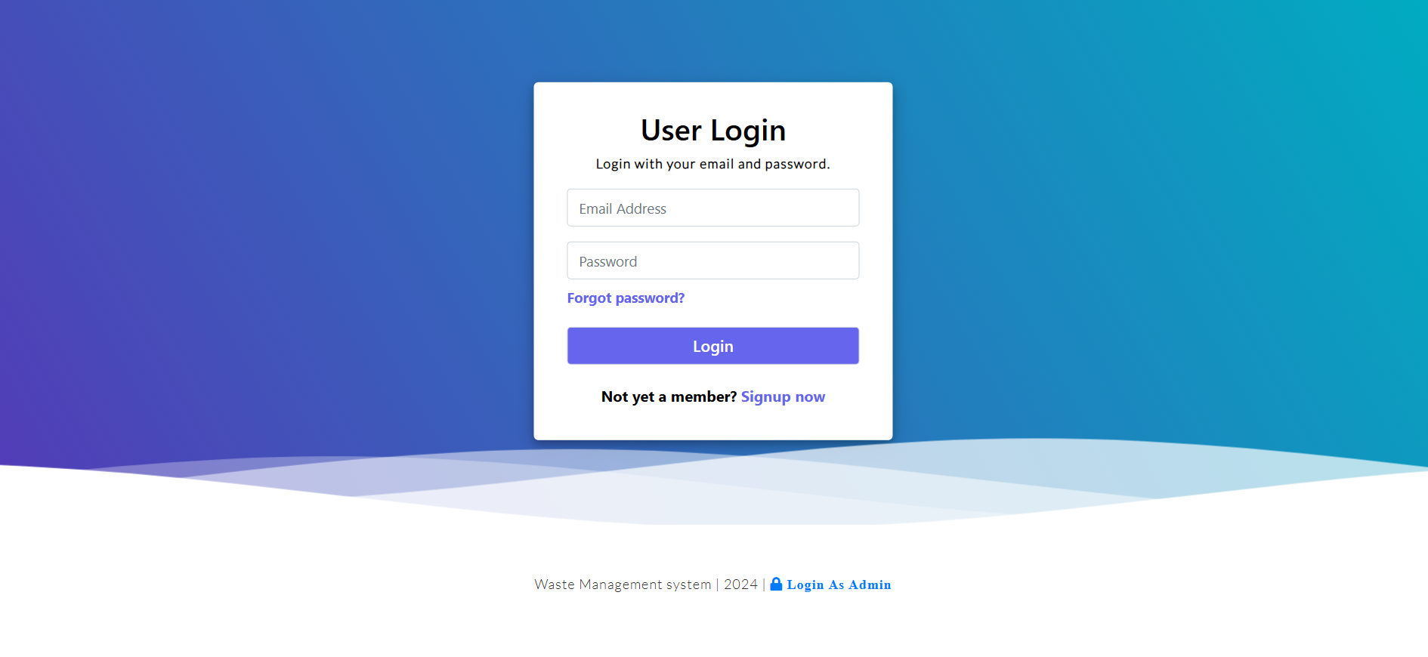
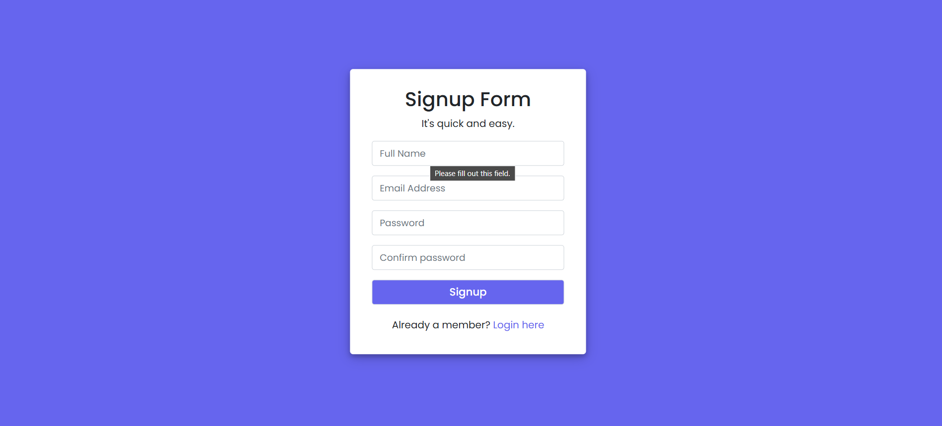
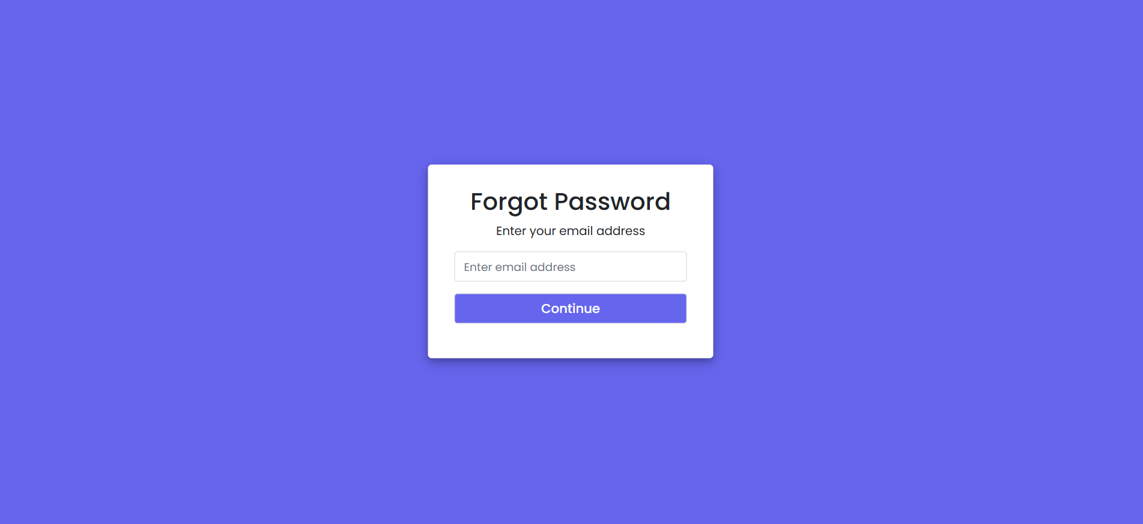
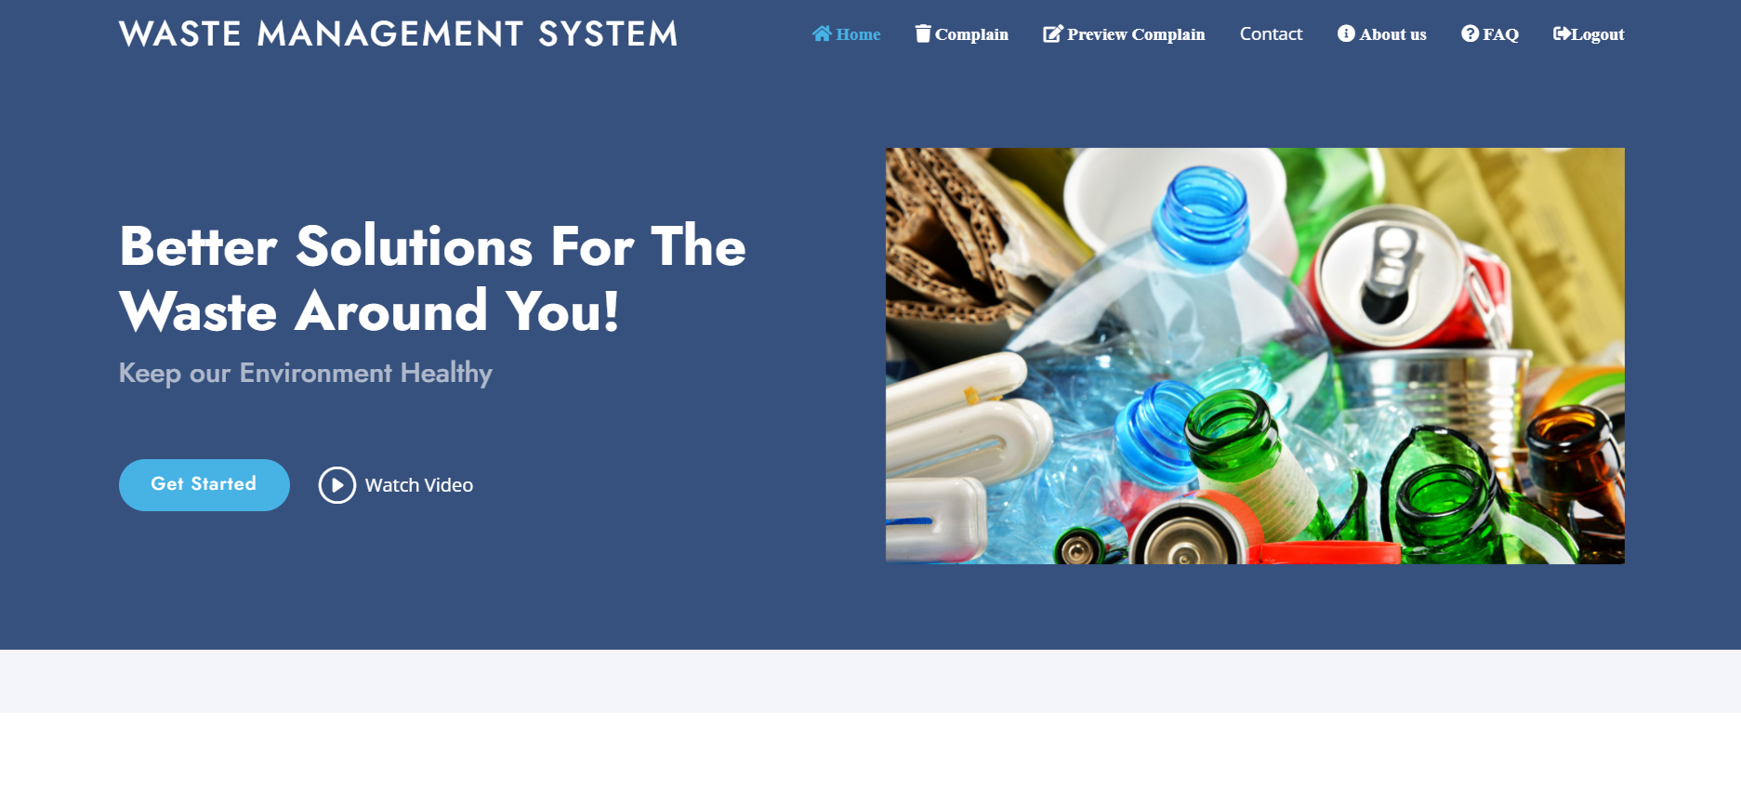
Design Phase
Software Project III Presentation

Slide 5


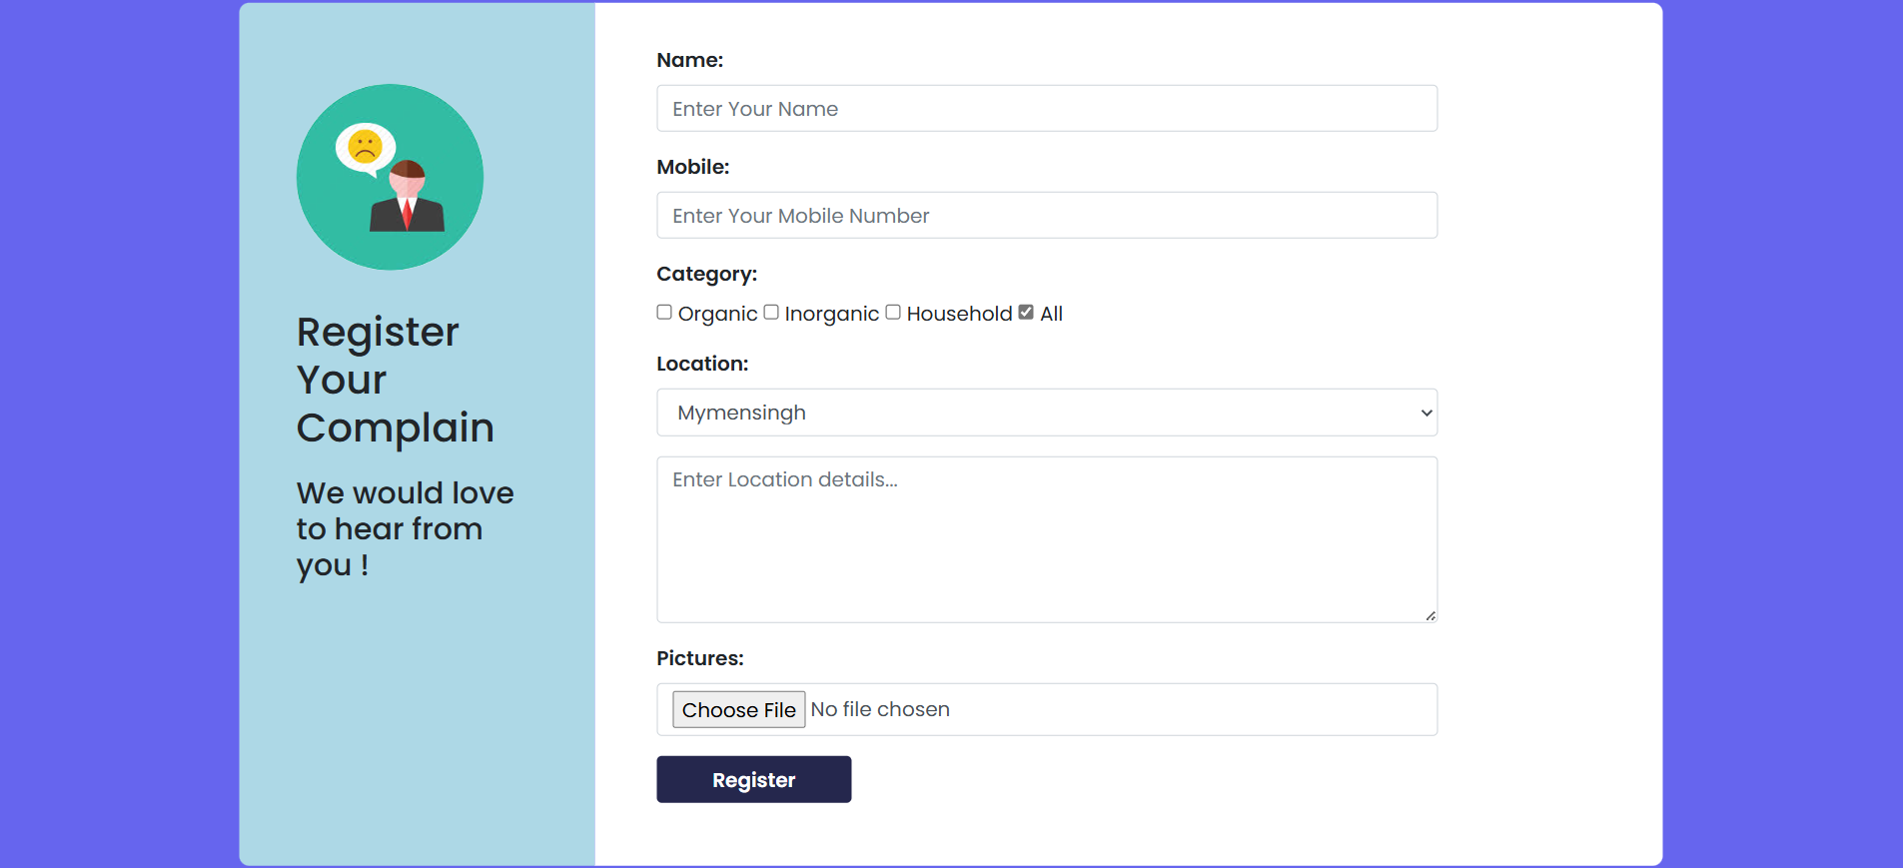
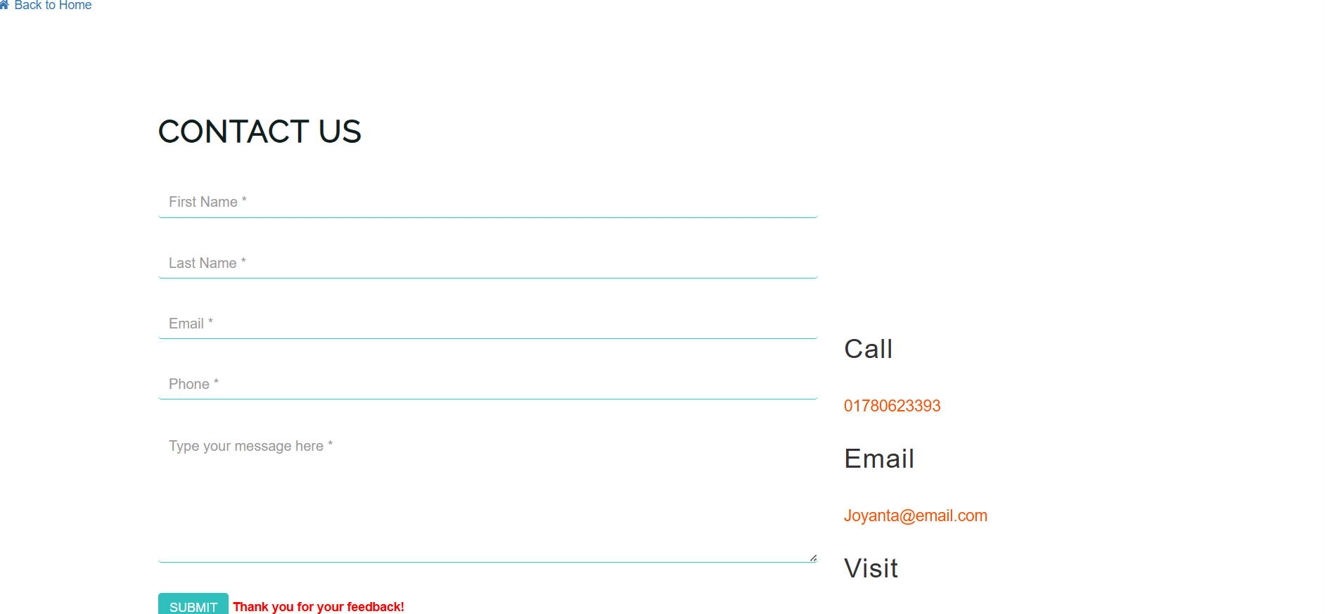
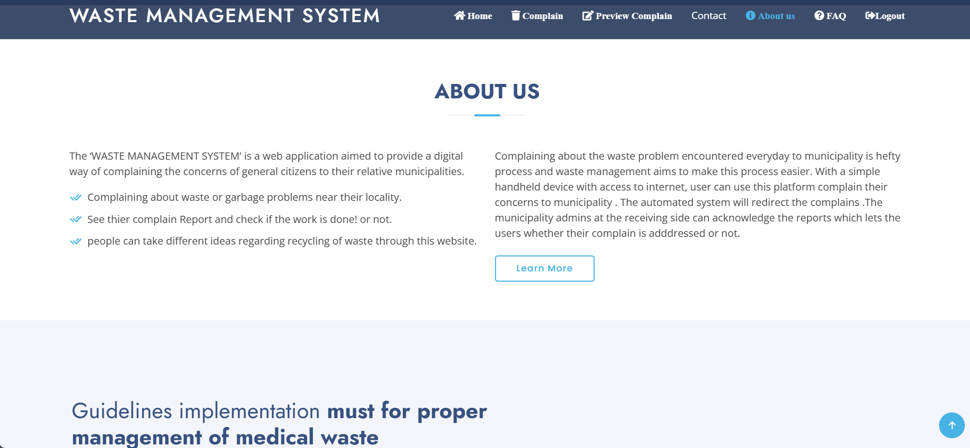
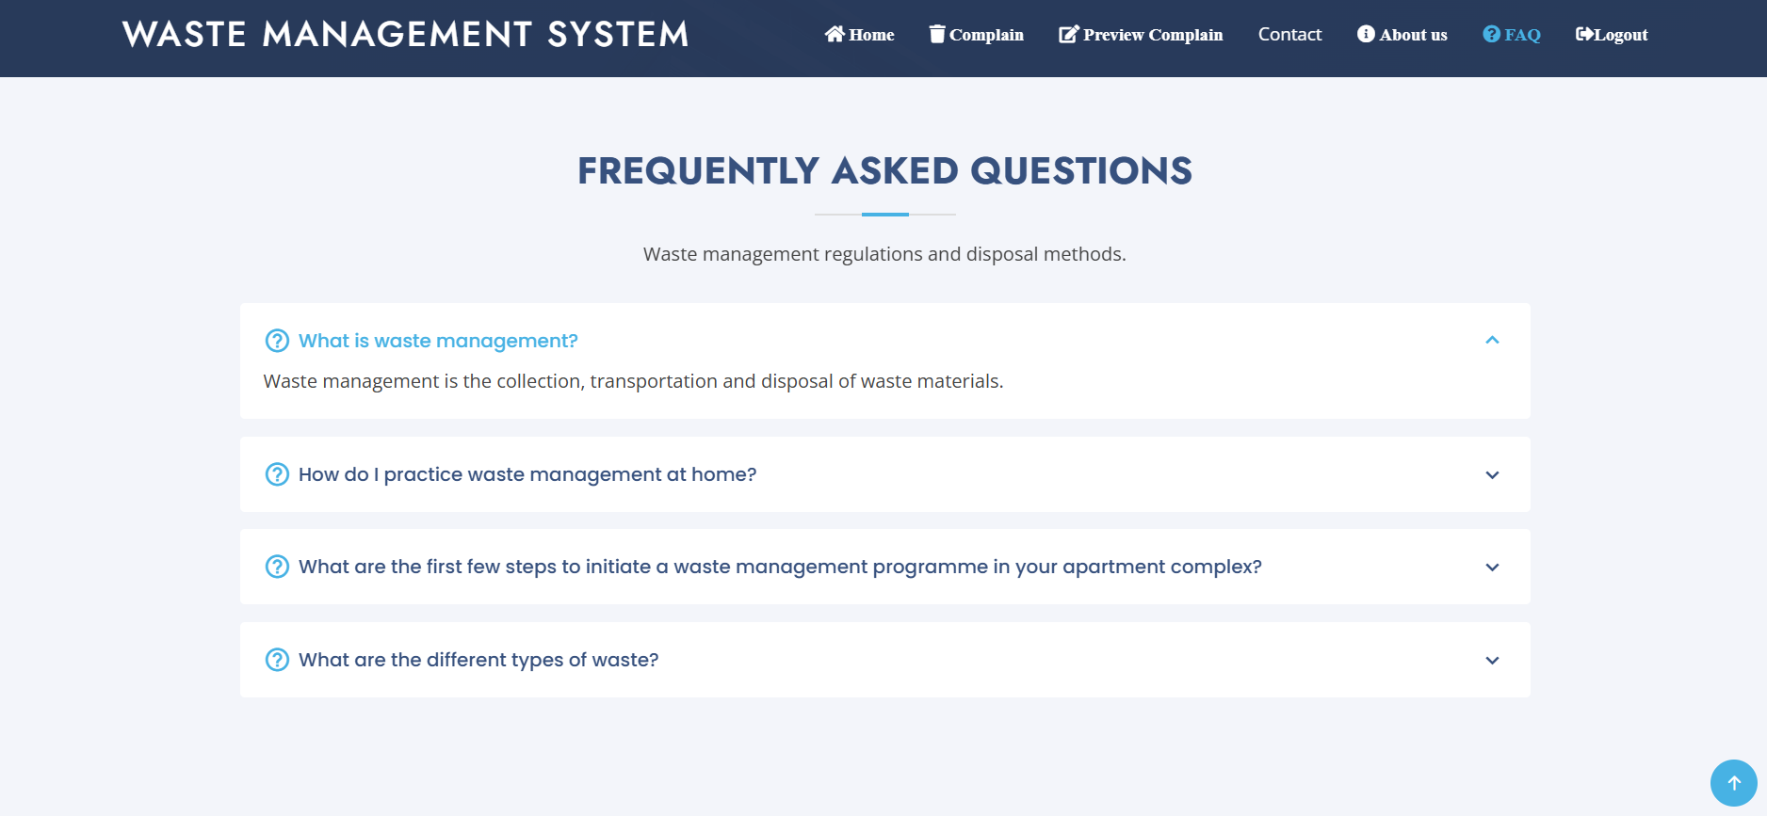


Slide 6
Development Phase
Requirement Analysis
Design
Implementation
Testing
Integration
Source Code: https://github.com/Al-amin19/Waste-Management-System
Software Project III Presentation

Slide 7



Future Work
JavaScript Integration
Backend Development
Advanced CSS
Software Project III Presentation

Slide 8





Conclusion
Successfully created a basic waste management system webpage.
Project serves as a foundation for future enhancements.
Encourages awareness about effective waste management.
Next steps involve adding interactivity, backend integration, and improving design.
Software Project III Presentation

Slide 9
Thank You
Software Project III Presentation

